Slide 1
Google Drive
P.A.L.M. Academy
Palm Springs High School
March 2, 2015

Slide 2
Paperless Classroom
Limitation on copying at our site
Time consuming and costly
Students are learning differently
Medical field is transitioning to electronic documentation
Students are expected to know 21st century technology skills

Slide 3
Common Core Standards
ELA 6-12.W.6- Students use technology including the internet to produce and publish writing
CC ELA 6-12.SL.4- Students present their ideas to an audience and address questions.
CC ELA 6-12.SL.5- Students make strategic use of multimedia, visual display & digital media in presentations.
CC ELA 6-12.W.5- Students give and receive critical feedback, which help improve their products through interactive series of revisions
CC ELA 6-12.W.4- Students produce clear and coherent writing appropriate to task, purpose and audience.

Slide 4
Site Level Requirements
Reliable internet connection
Chromebooks cannot be used without a connection
Electronic devices
Training staff to:
Use Chromebooks
Google Drive
Using educational apps in the classroom

Slide 5
What is Google Drive?
Google Drive is a ‘cloud’ based platform that provides a scaled down version of Office productivity applications such as documents, presentations, and spreadsheets, as well as a multitude of applications to promote student creativity to tailor an individualized learning experience.

Slide 7
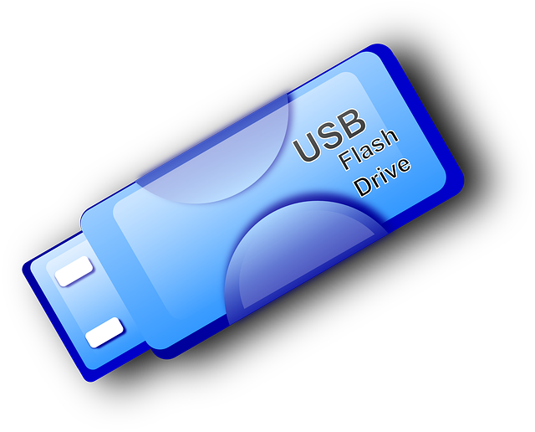
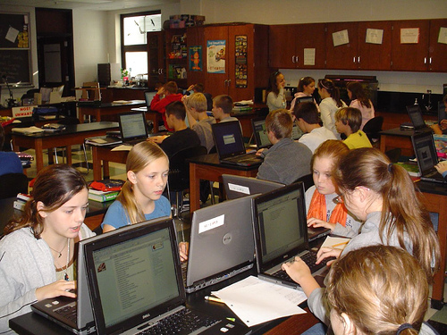
Why Use Google Drive?
Facilitate peer, group, teacher, staff collaboration
Large Cloud storage which means preservation of hard drive space
Access drive from any device and anywhere
Real time collaboration
Monitor student progress
Work from home

Slide 8
Revision history
Publish to web
Translate to multiple languages
Increase student engagement
Promote literacy skills

Slide 9
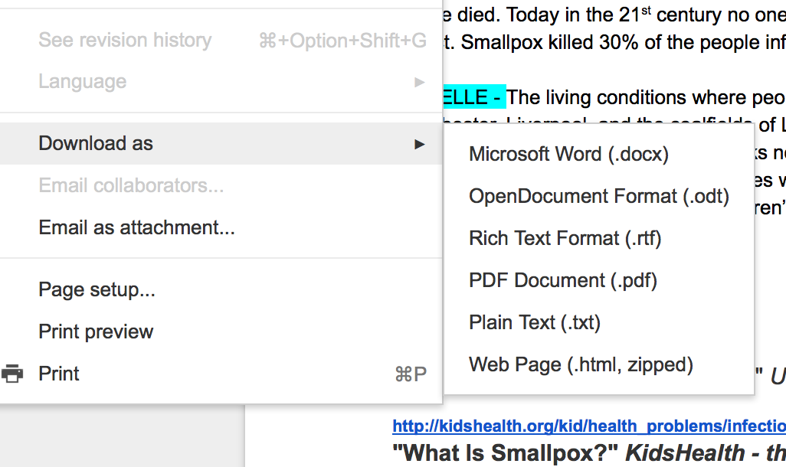
Download to Desktop

Slide 10
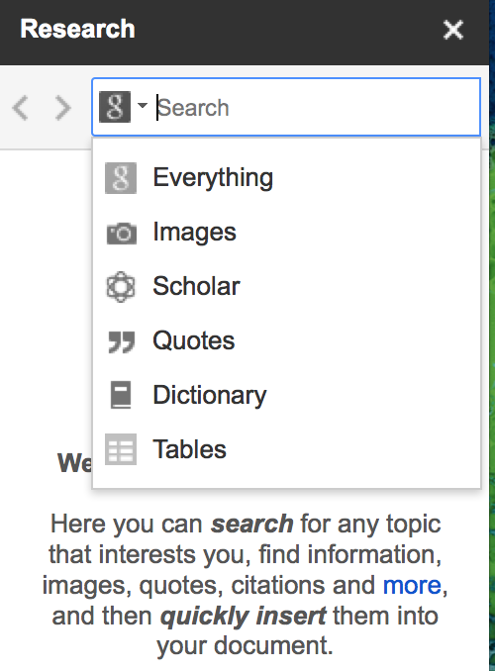
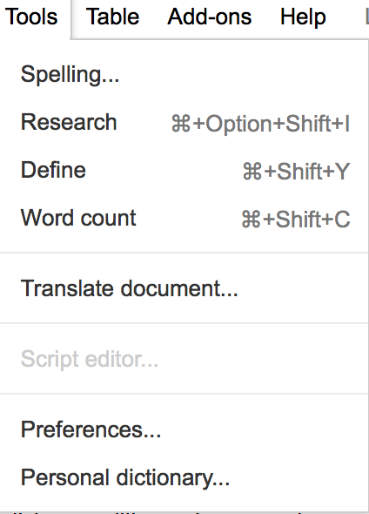
Research

Slide 11
Collaboration & Google Doc
Teaching Channel

Slide 12
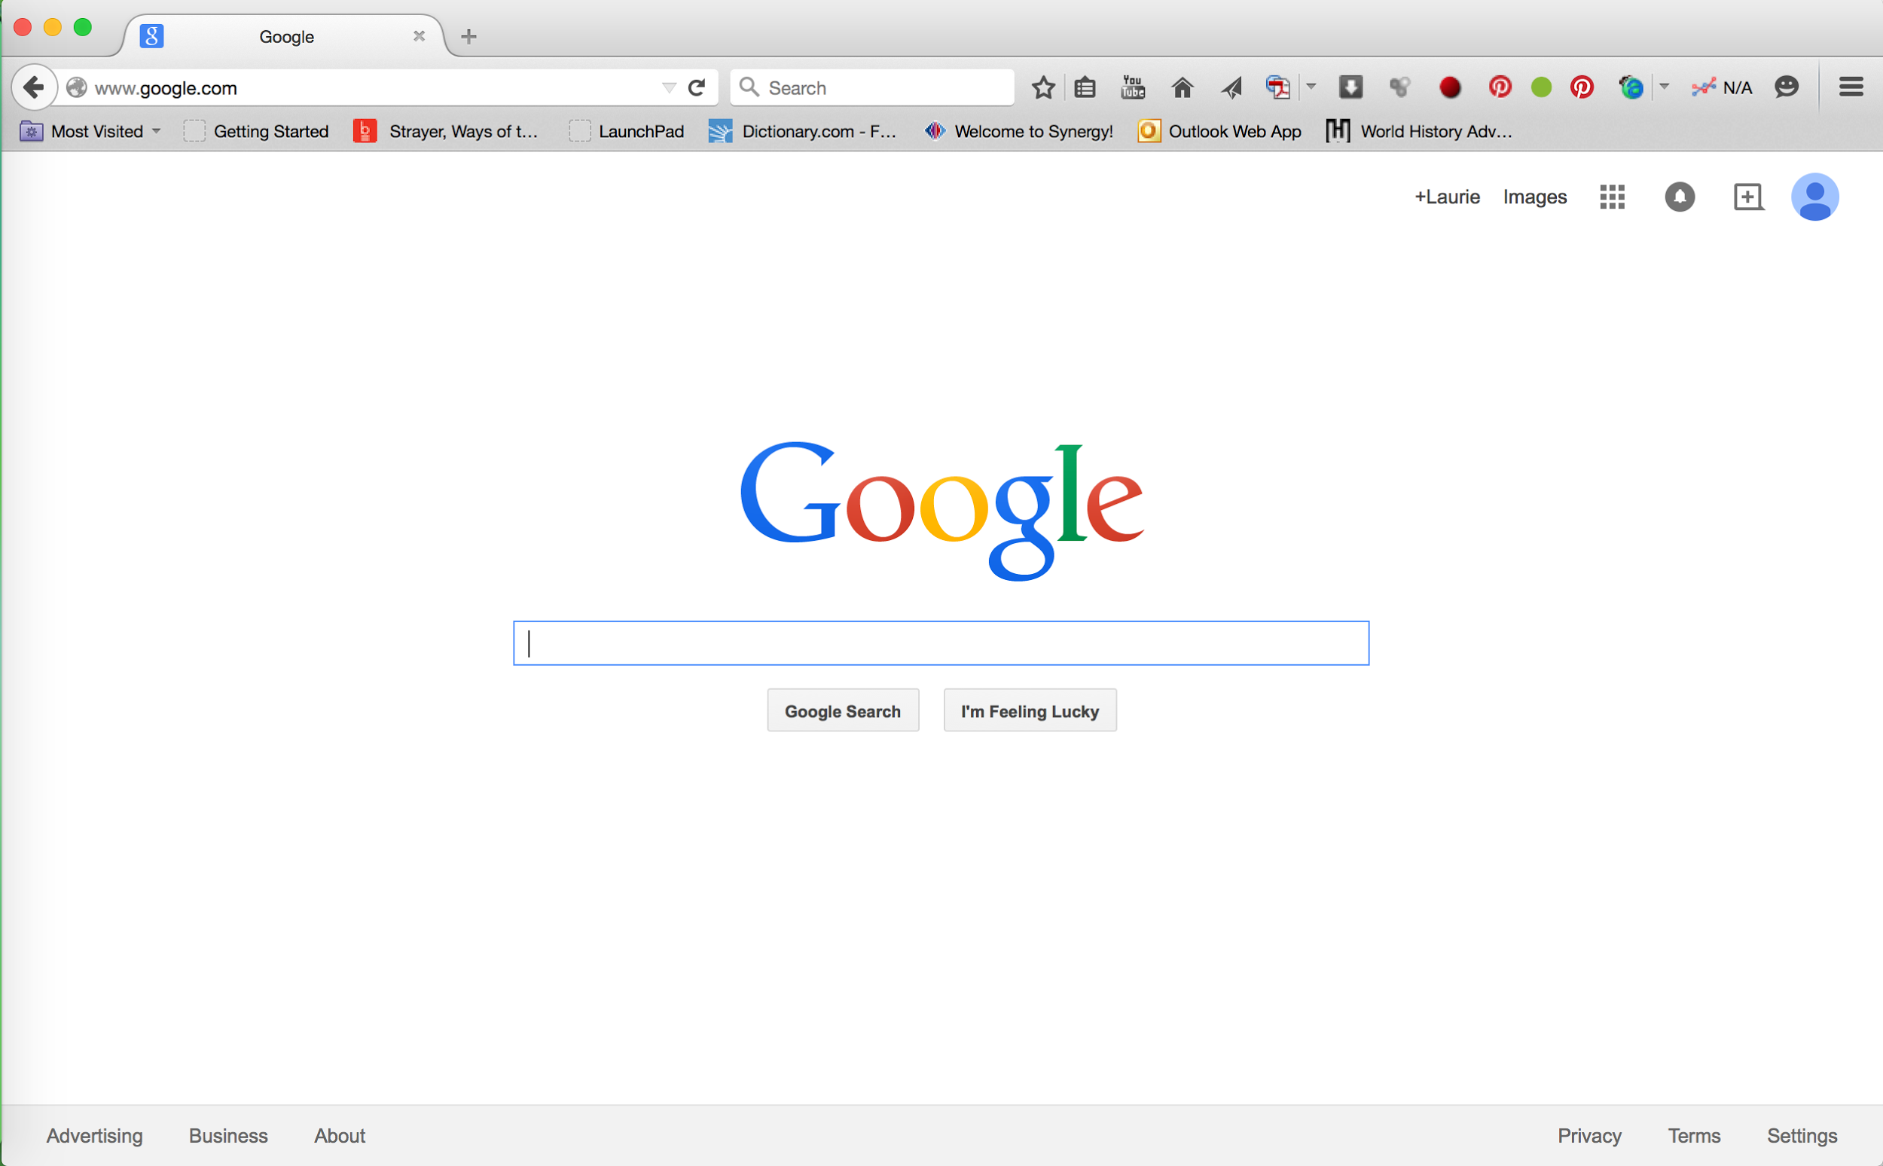
Click here to access drive
Click here to sign-in

Slide 13
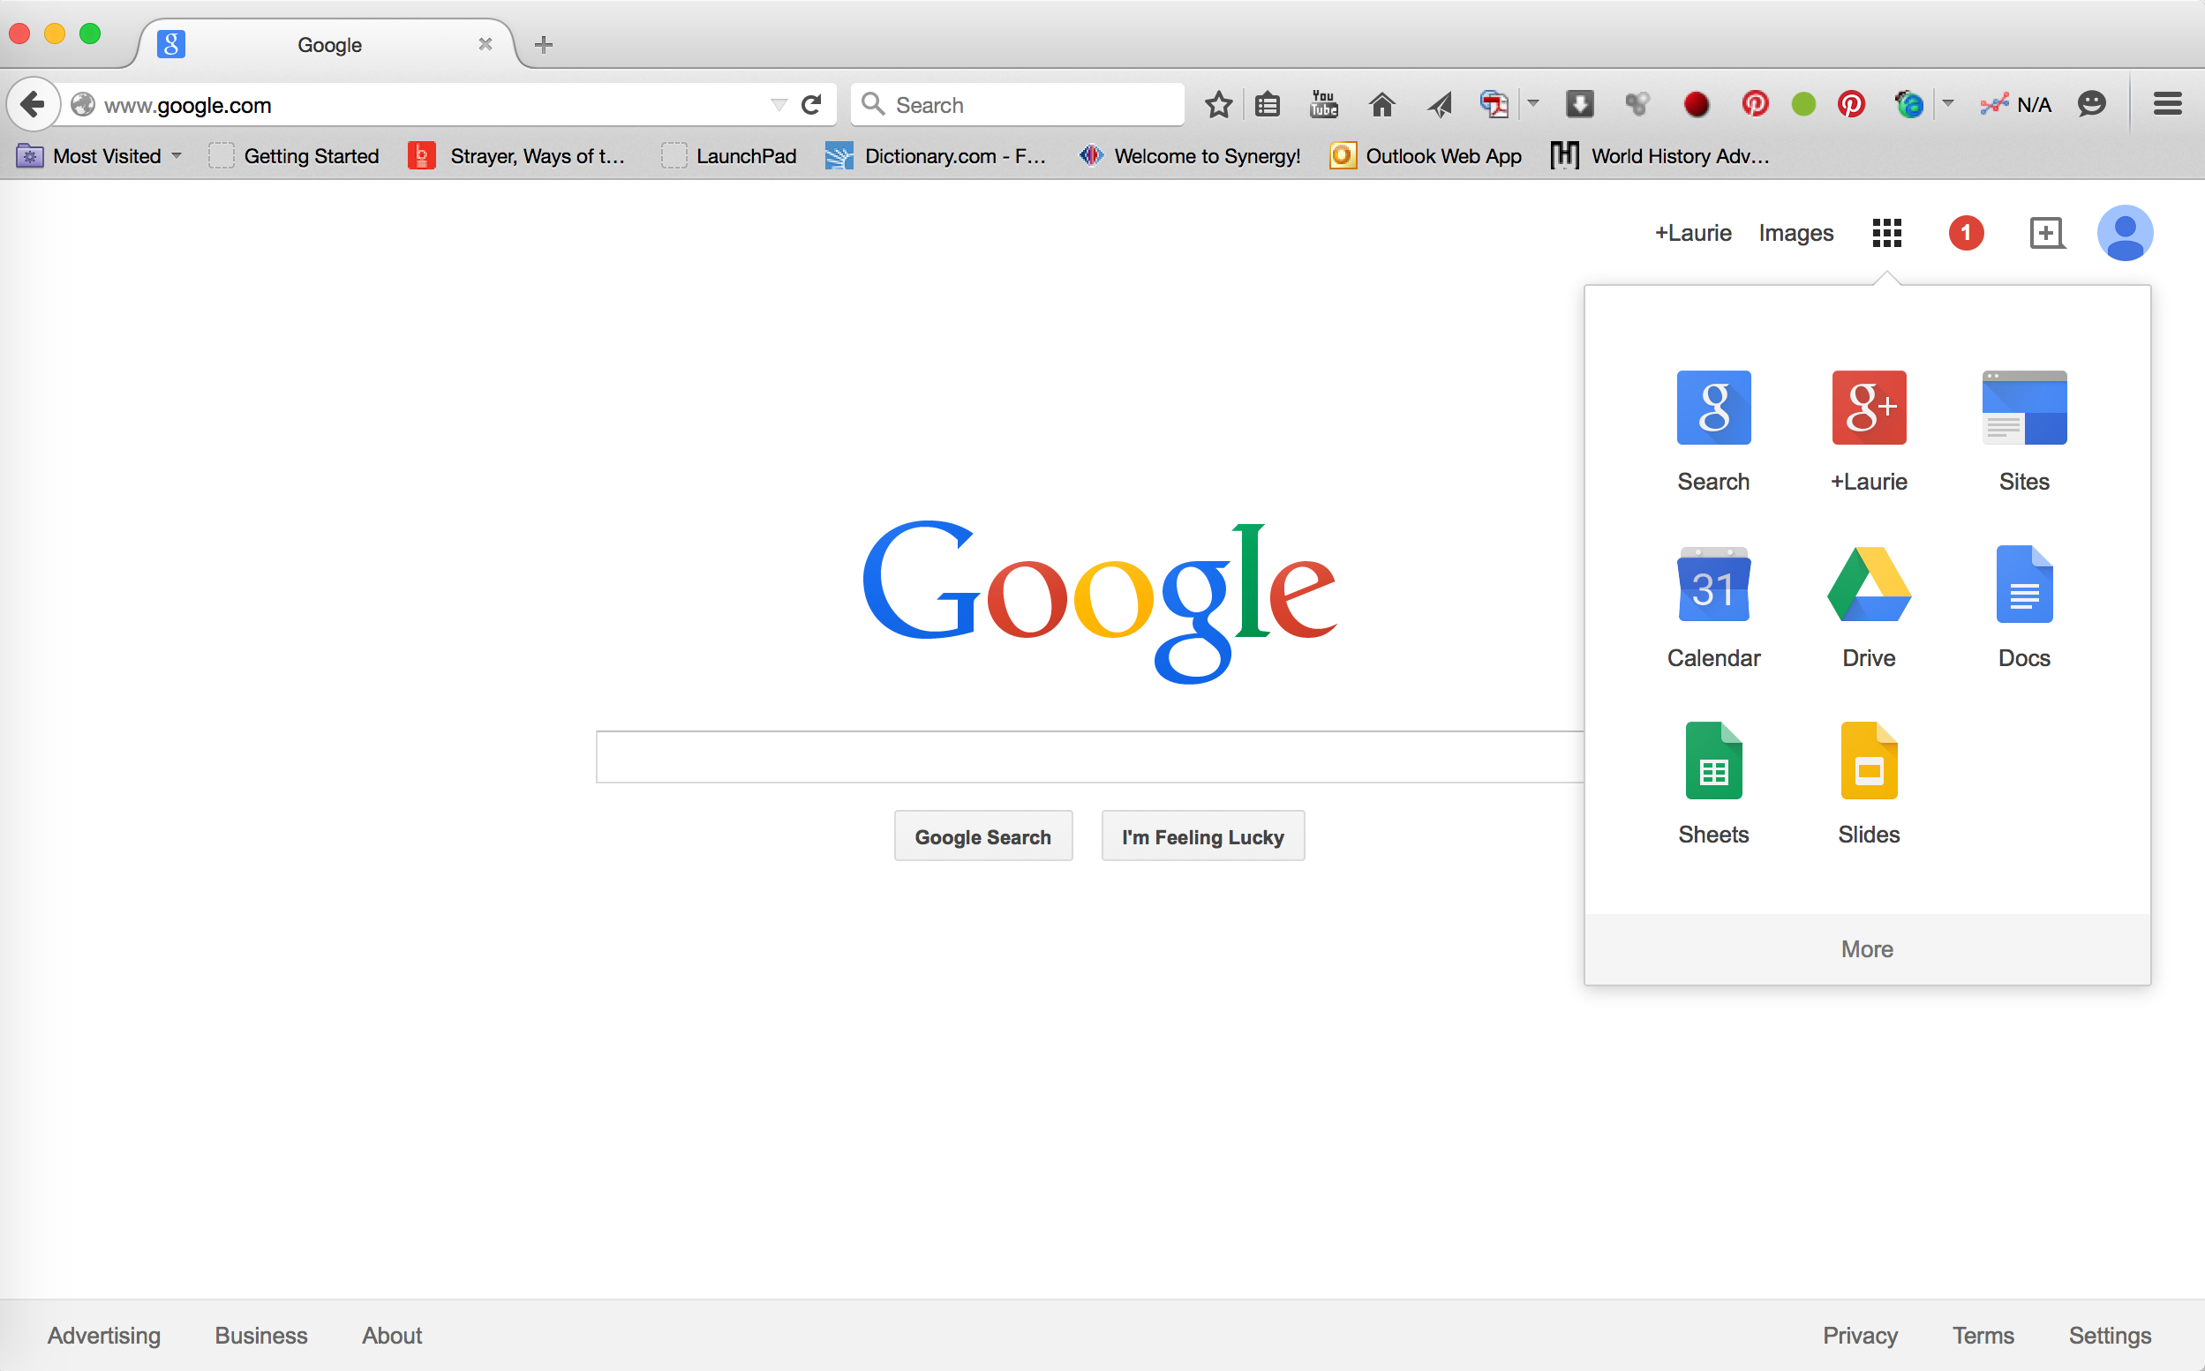
Click on Drive to access

Slide 14
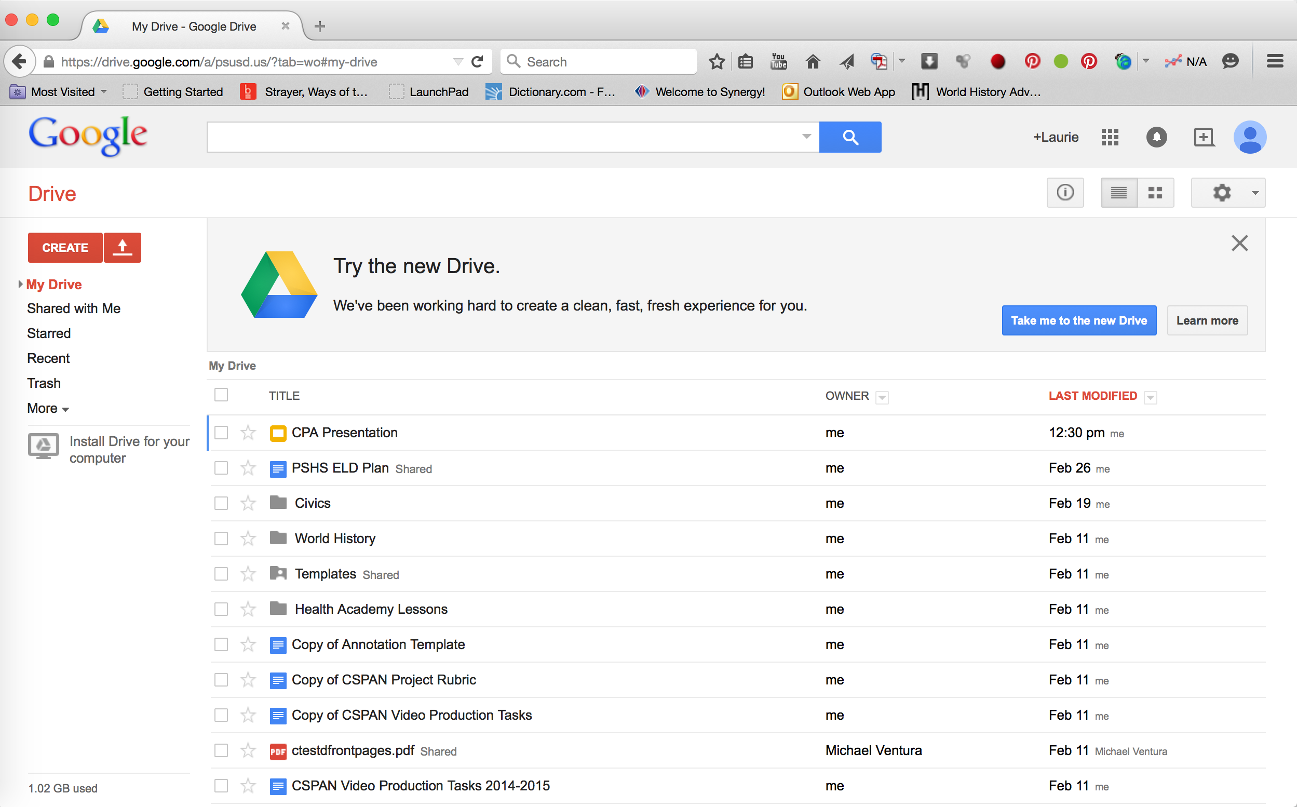

Slide 15
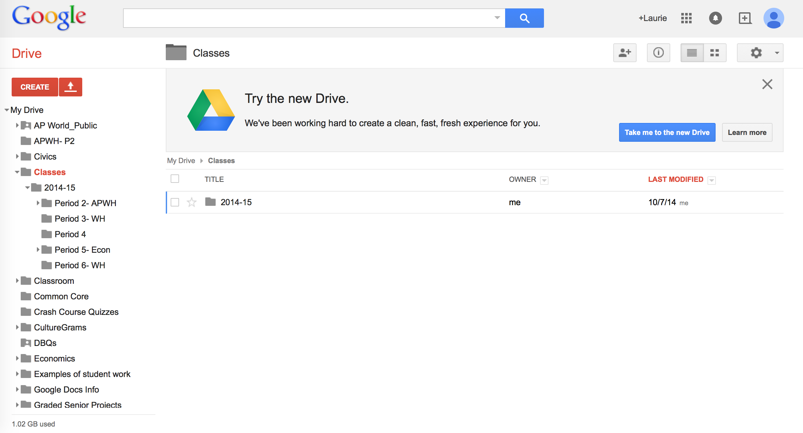

Slide 16
Creating Documents
Whoever creates the document is automatically the owner
the document is only visible to the owner until it is shared
Documents should be shared with students as “view only” so that the format is preserved.
Students make a copy to their drive to edit
Then students can share the copy with their peers

Slide 17
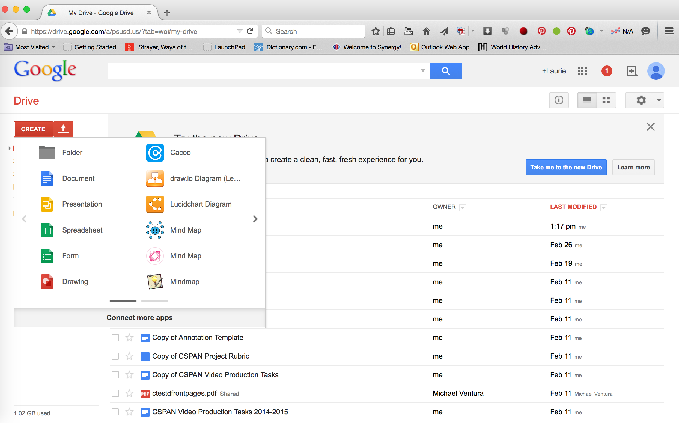
Click “create” to begin a new Doc, Presentation, Spreadsheet, ect...

Slide 18
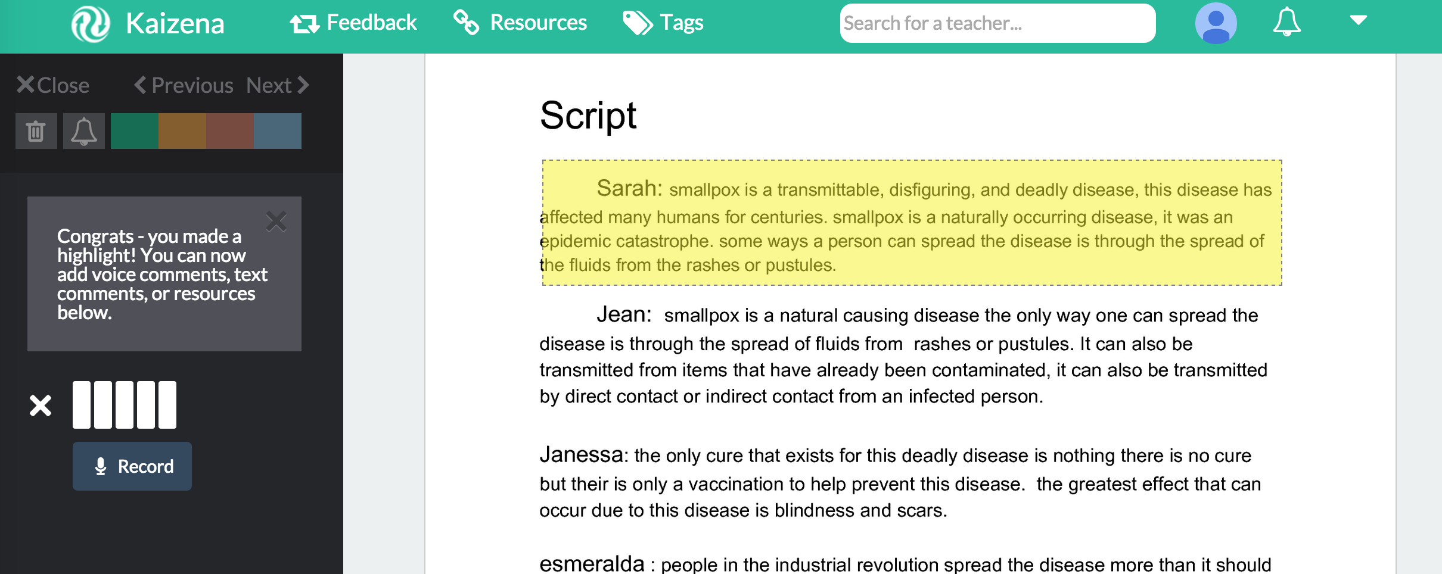
Voice Comments
Leave oral feedback to save even more time while assessing student work.
With Kaizena text is highlighted as you provide comments

Slide 19
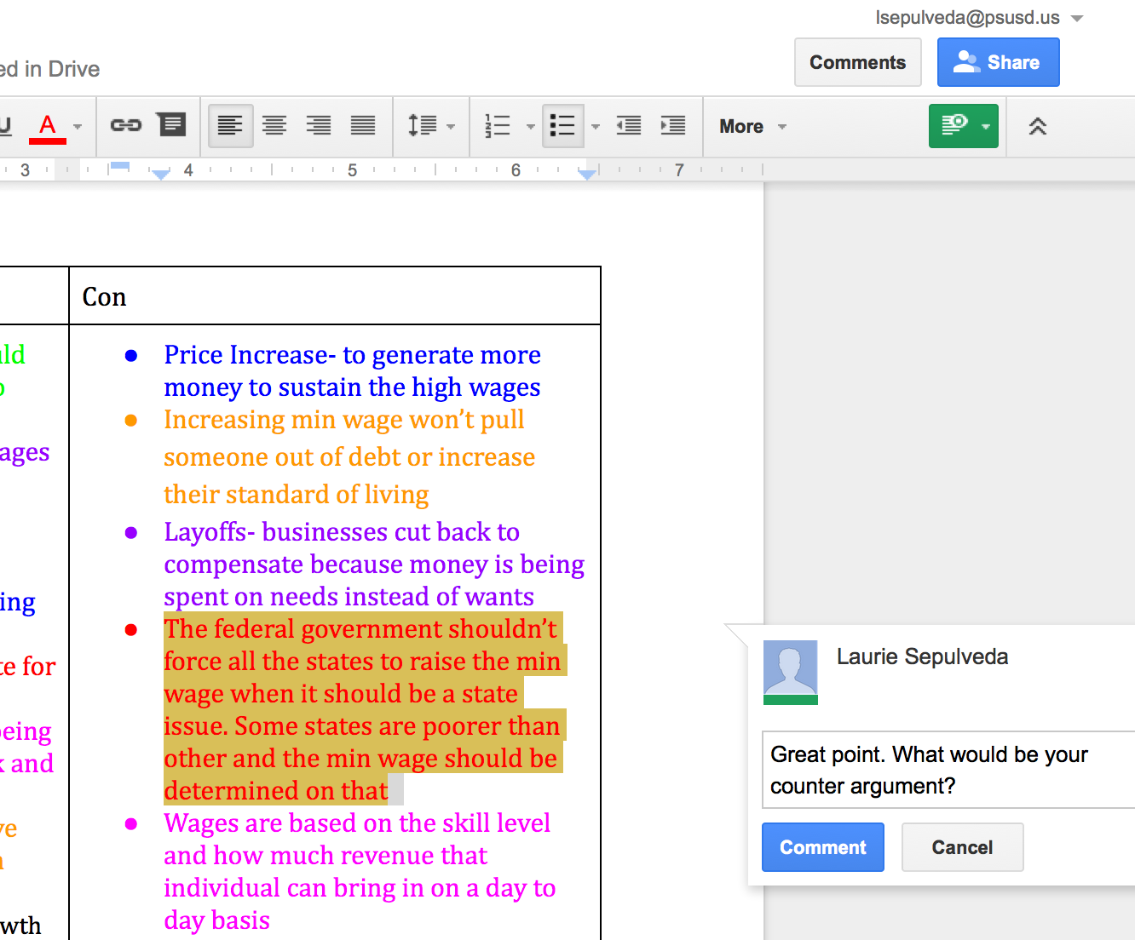
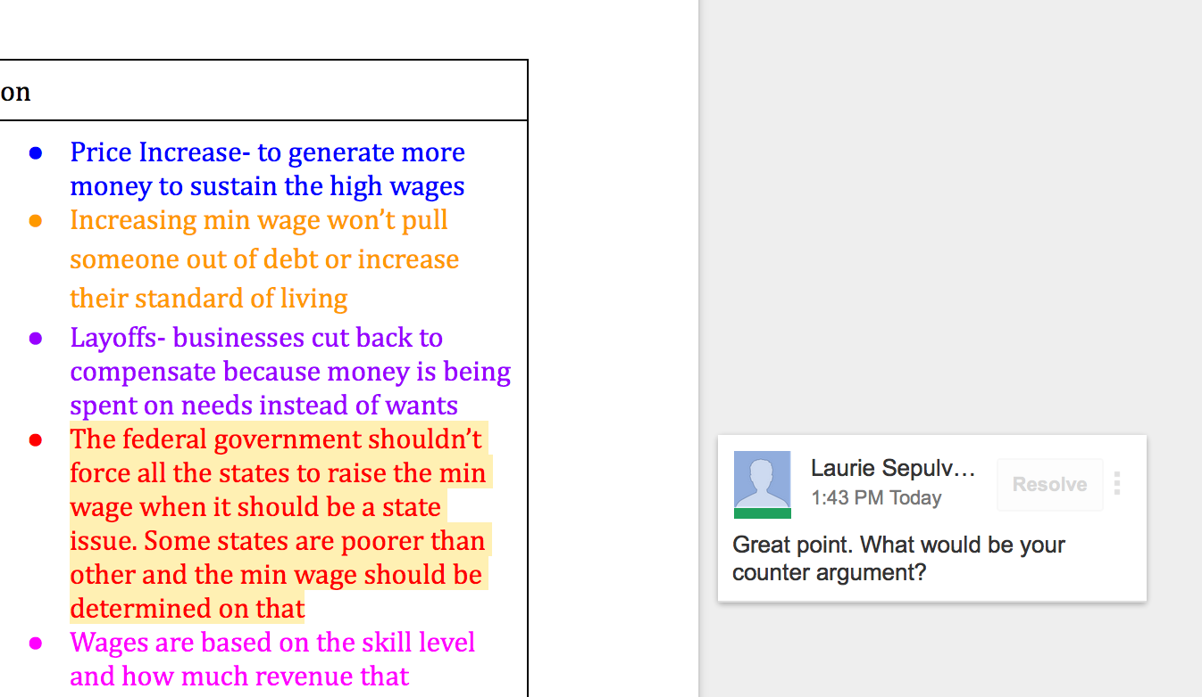
Leaving Feedback
Save time grading by typing feedback directly onto Doc.
Item in review will remain highlighted until suggestion is resolved.

Slide 20
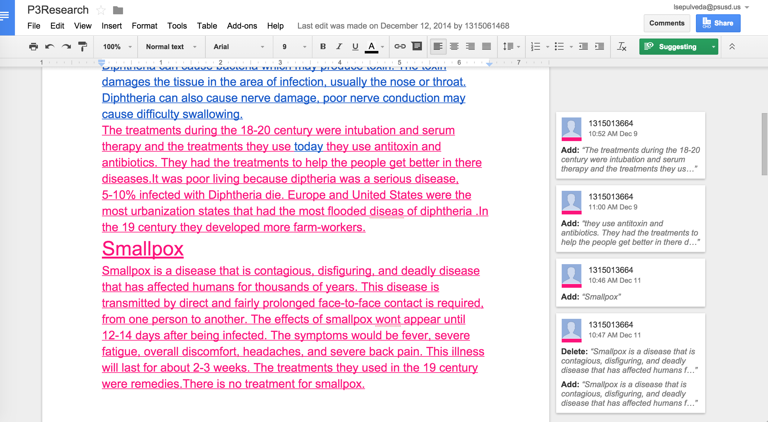
Example of Student-to-Student Collaboration

Slide 21
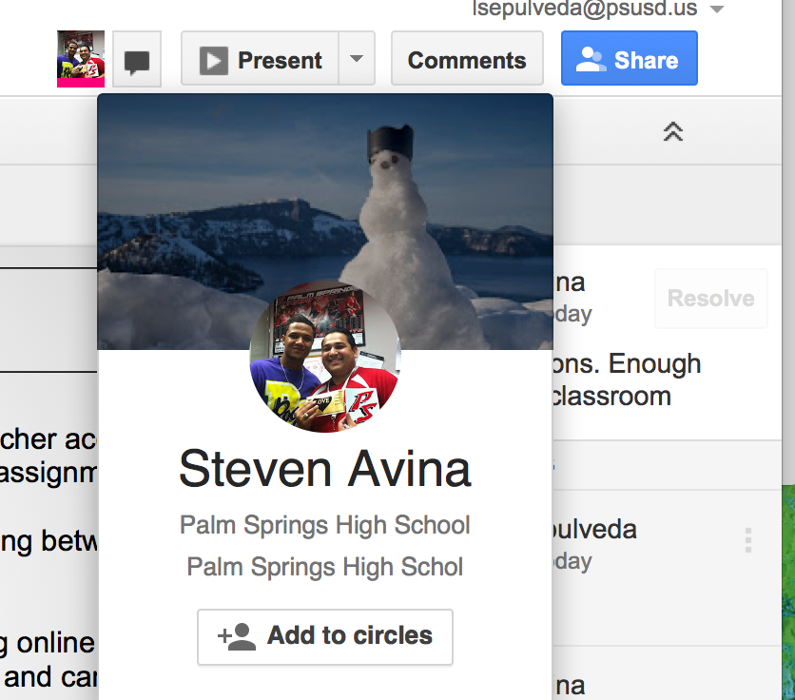
See which team members are collaborating

Slide 22
Sharing Through Google Drive
Share with anyone
View only
Can comment
Can edit
Collaborate in real time from any location

Slide 23
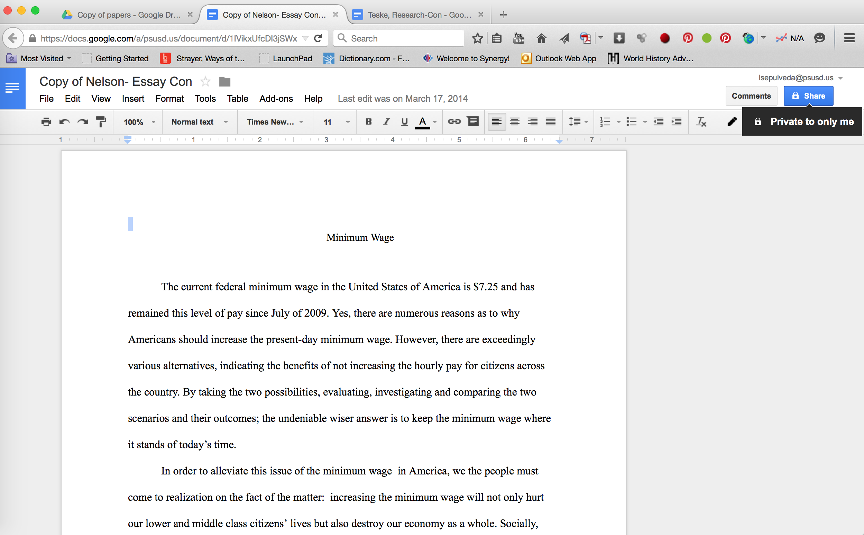
Adjust share settings & leave comments

Slide 24
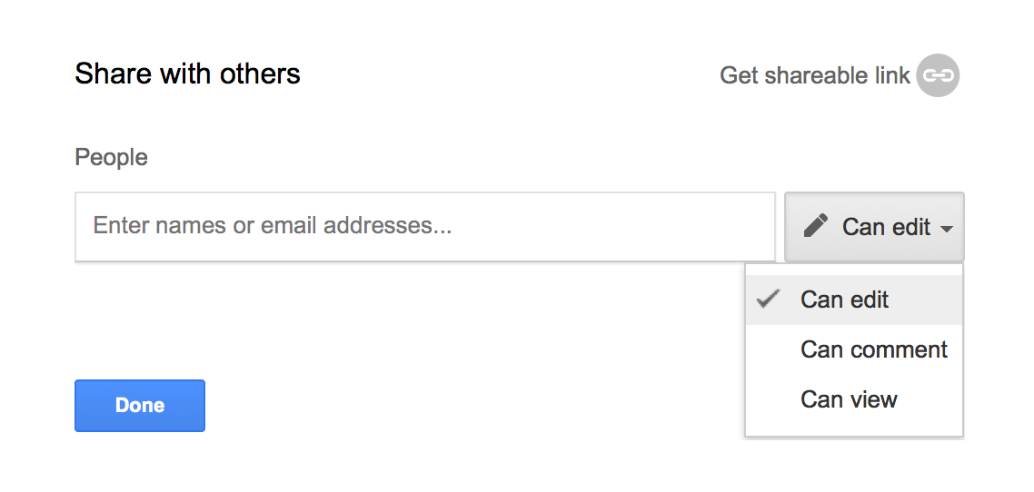
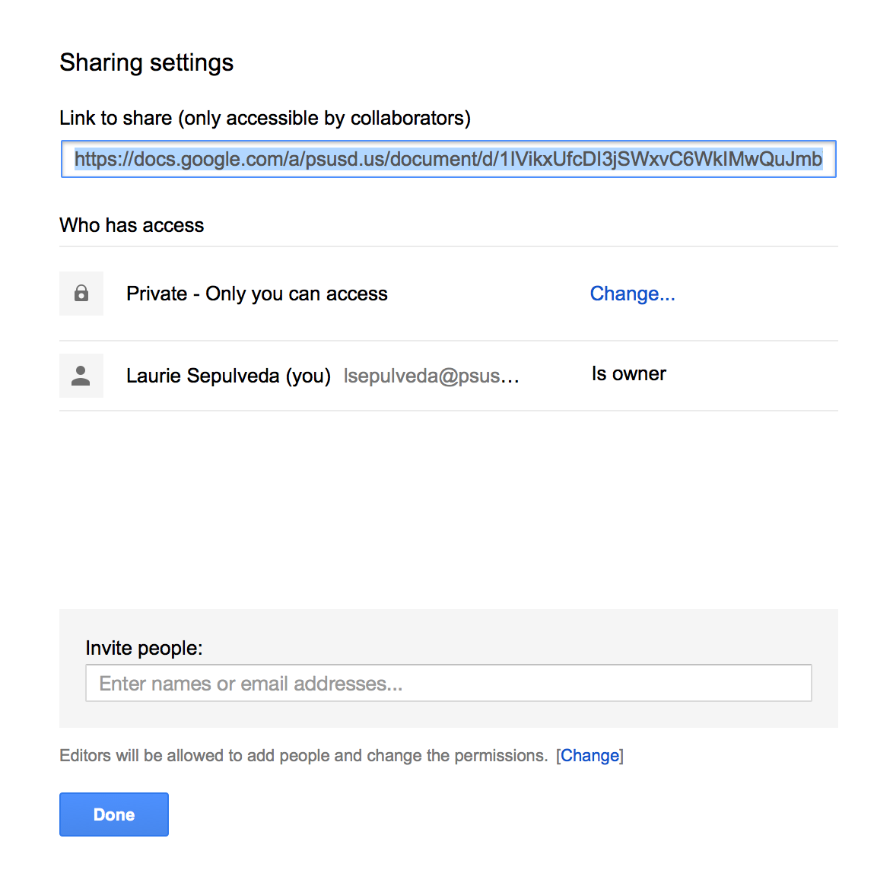
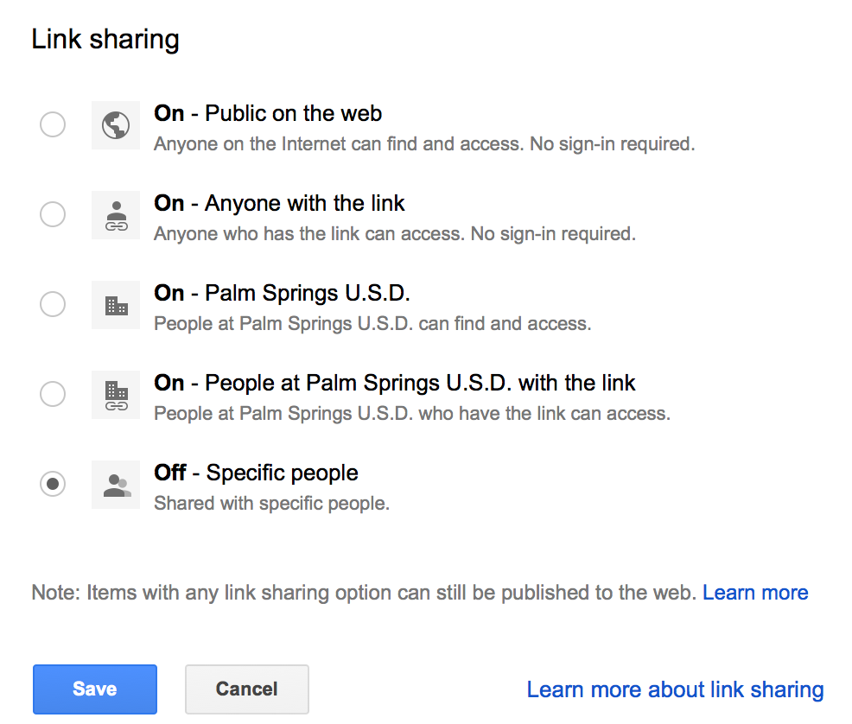
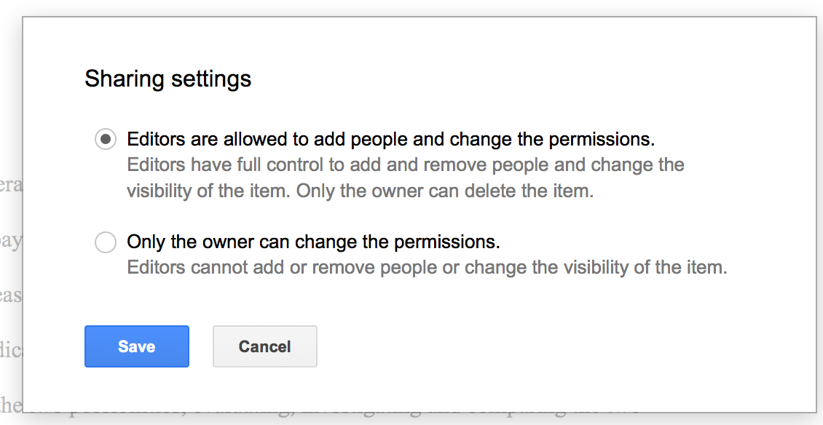
-Collaborate
-Make Notes
-Read-only

Slide 25
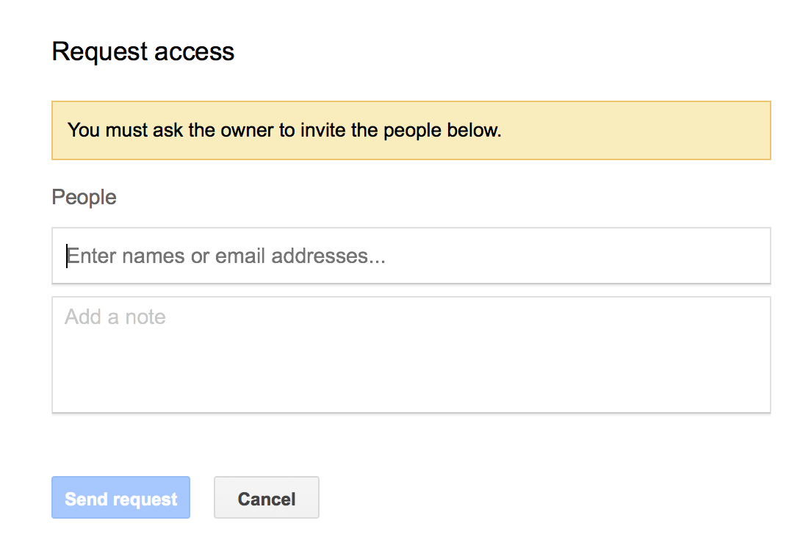

Slide 26
Google Slides
Presentations
Save paper and ensure participation of all group members
Review Activities
Students review together as opposed to individually
Incorporate video & music to create a more engaging presentation

Slide 27
Google Slam

Slide 28
Movenote
Create interactive presentations
No more standing up in front of the classroom
Allows students to record themselves discussing content using built in camera

Slide 29
Movenote

Slide 30
Google Forms
Surveys
Quizzes/Tests
Quickly analyze data
which is automatically transposed & organized into a spreadsheet
Grade reports & graphs
Email result back to students

Slide 31
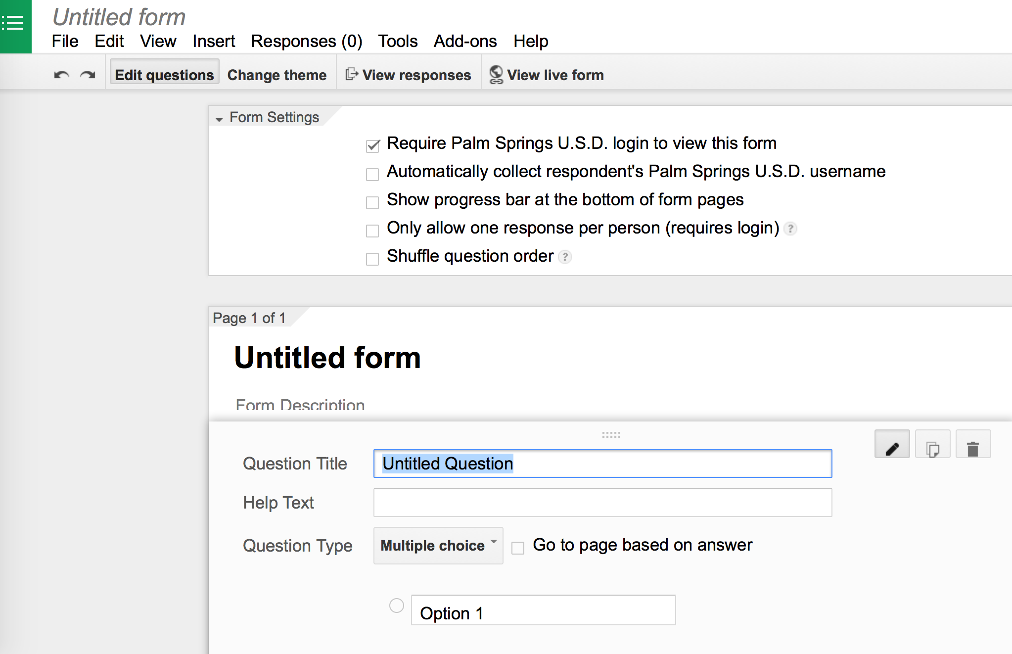

Slide 32
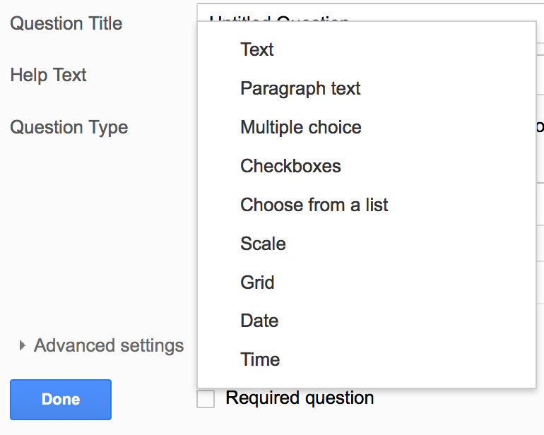
Select the Type of Question

Slide 33
Google Forms in a Flash

Slide 34
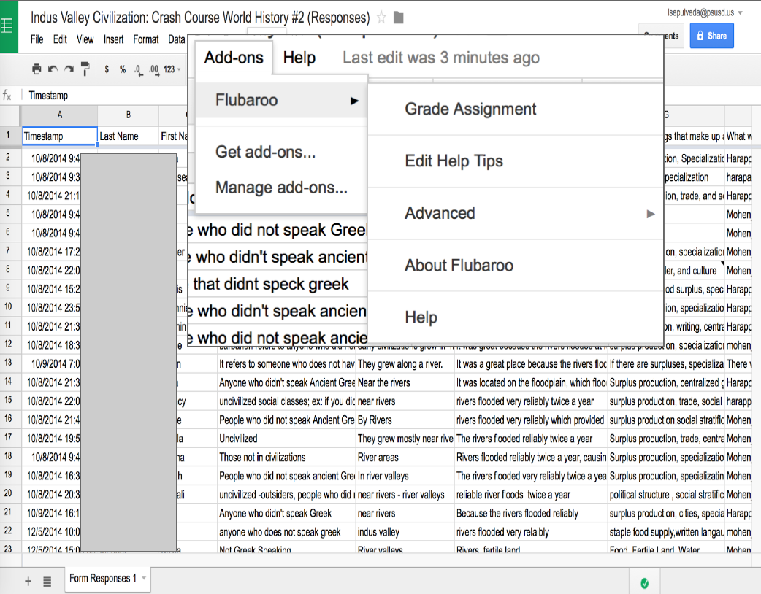
Flubaroo
A Chrome add-on
Grades within seconds
Tabulates points
Good for grading non-open ended questions

Slide 35
Flubaroo Demo

Slide 36
Google Classroom
https://classroom.google.com/
Separates students by period
Can use classroom instead of creating a website
Push out assignments to each student
Students get their own copy of the assignment with their name already appended to document
Set due dates
Create, collect, grade and reassign all in one place
Provide feedback
View who did/did not complete the assignment

Slide 37
Google Classroom

Slide 38
Pros
Documents stored in the cloud
Access to drive from anywhere and any device
Autosave
Share feature without having to use email
Real time collaboration
Text and voice comments
Instant feedback
No lugging back and forth assignments between home and work
Simultaneous collaboration
Engaged students
Individualized instruction
Improve communication and literacy skills
Create a blended learning environment (face-to-face & online)
Download apps onto Chromebook without calling technology to update device

Slide 39
Cons
Learning curve
Time required to set up student/teacher accounts
Ensuring students name folders & assignments properly
Possibility of plagiarism when sharing between students
Students using different platforms
Reluctant parental consent granting online access
Students use wrong share settings and cannot collaborate
When using can “edit” share setting one person can delete everything produced
Loss of formatting when uploading personal files to Google Drive
Cannot edit files unless converted to Google version of file
Not having enough Chromebooks in the classroom
Not all students have access to technology & the internet at home
Varying degrees of student technology awareness
iPads are not ideal for using Google Drive

Slide 41
Contact Information
 | Role | Email
Steve Avina | PALM Counselor | savina@psusd.us
Cathy Campbell | PALM Coordinator Science Instructor | ccampbell@psusd.us
Laurie Sepulveda | Social Science Instructor | lsepulveda@psusd.us
Michael Ventura | CTE Instructor Athletic Trainer | mventura@psusd.us

